Slide 1


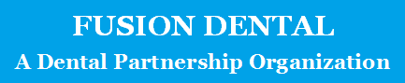

STRENGTH THROUGH PARTNERSHIP

Slide 2

A Degrading Situation
The Landscape has Changed
  Industry increasingly focused on profit
  General Dentists being squeezed by “Corporate Offices”
    More resources
    Able to negotiate
      better insurance rates
      Lower supply costs
  FUTURE - BLEAK

Slide 3
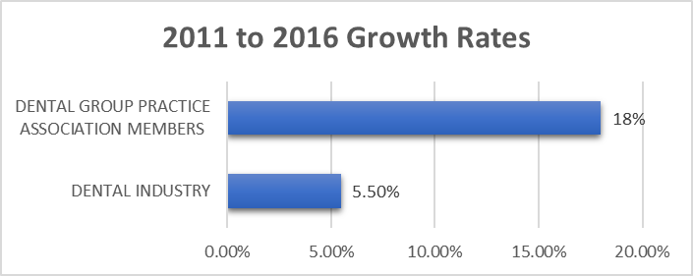
A Degrading Situation
From 2011 to 2016 Dental Group Practice Association membership grew at three times the rate of the industry.
Notes:
The US dental care industry expects a healthy Compound Annual Growth Rate of 6% in the foreseeable future.

Slide 4
WHY
Economies of scale
Work/Life balance
Increased profits

Slide 5

WHY: Economies of Scale
Less Headache’s for Dentists = Work/Life Balance
Hiring/Recruiting
Supplies
Employee reviews
Insurance
Call Center
Payroll
Marketing
Accounting
Taxes
Capital
Risk Management
IT Services
Practice Support

Slide 6
WHY: Increased Profits

Slide 7
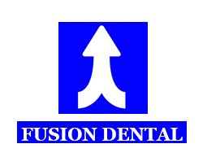
THE PROBLEM
How do you keep the best attributes of the small office while allowing for the efficiencies and return of a large group practice or DSO?

Slide 8
THE ANSWER: FUSION DENTAL
Fusion Dental merges the practice philosophy of a smaller practice with the freedom brought about by modern practice management techniques, advances in technology, and the efficiencies of a group practice.

Slide 9
THE ANSWER: FUSION DENTAL
Dentist owned and led.
Allows dentists to concentrate on patient care and leading and training your clinical team.
Business within a business.
Responsible for all non- clinical functions (the headache’s).
Allows for investment in multiple offices.

Slide 10

THE ANSWER: A LIFE WORTH LIVING
Clinical autonomy, job security, and prosperity.
The ability to thrive competing with larger, well financed organizations.

Slide 11
THE ANSWER: A LIFE WORTH LIVING
The freedom to balance your work and personal life.
Supported by technology, training, and the ability to network with other dentists.

Slide 12
THE ANSWER: PATIENT CENTERED
Interdisciplinary care under one roof.
Markedly improved Patient care.
Office becomes a “Dental Home”

Slide 13
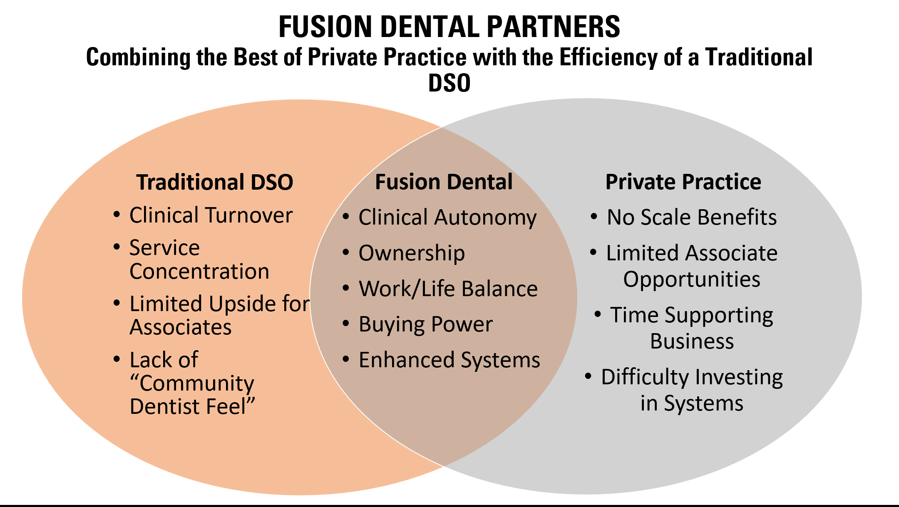

Slide 14
COMPETITIVE ADVANTAGES: SPECIALISTS
Rotating Specialists Allows for Continuity of Care
Better Collaboration
Convenient for Patients
Increased Collections
Makes Practice a “Dental Home”

Slide 15
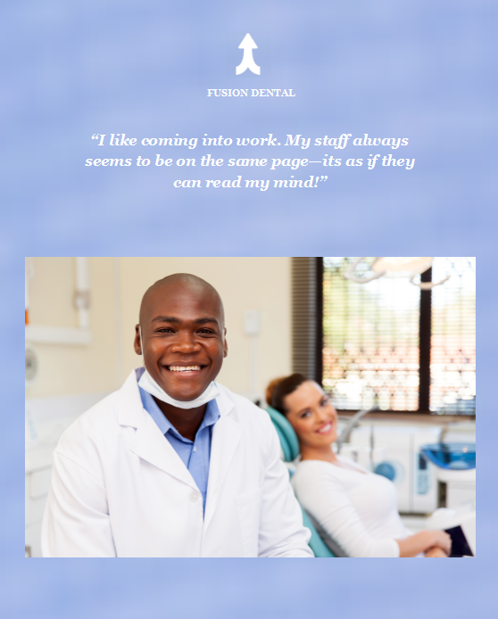
COMPETITIVE ADVANTAGES: CULTURE
Core values include integrity, humility, passion, accountability, selflessness, and profitability.
Our organization adheres to its beliefs to guide all patient care and business decisions.
Hiring people that fit our culture makes for a happy work environment.

Slide 16

COMPETITIVE ADVANTAGES: TRANSPARENCY
An open book system of accounting.
Progressive bonus system based on financial outcomes, continuing education, and performance outcomes as set by our specialist led clinical staff.

Slide 17

COMPETITIVE ADVANTAGES: LEADERSHIP
Dentist controlled and led.
Non-clinical professionals mission is to support the clinical staff.
Focused on patient care.

Slide 18
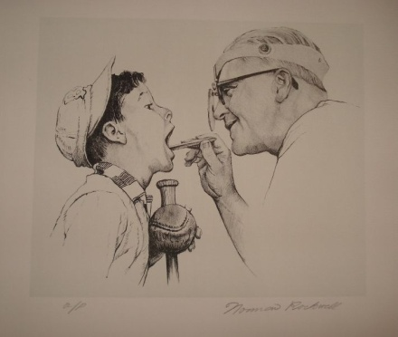
COMPETITIVE ADVANTAGES: PATIENT FOCUSED
Direct Marketing
Patient Oriented Practice Philosophy
Speed of Patient Appointments
Financing
Convenience

Slide 19
COMPETITIVE ADVANTAGES: OPERATIONS
Operations
  Systems Based Practice –Through standardization Fusion Dental will increase efficiency, decrease training times, and drive down costs.
  Technology – The Multi-Specialty Center believes firmly in investing in technologies that improve outcomes, shortens treatment time, and provides a return on investment.
  Transparency - The Multi-Specialty Center has transparency in all financial dealings with investors and staff.
  Culture – The Multi-Specialty Center has a unique culture based on integrity, humility, kindness, passion, accountability, selflessness, and profitability.

Slide 20
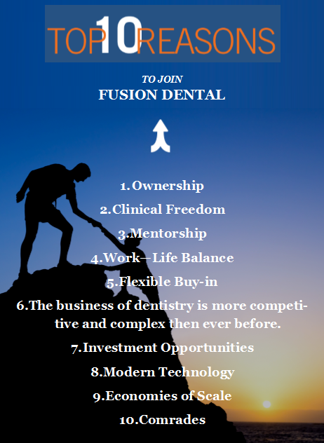
COMPETITIVE ADVANTAGES
RECRUITING

Slide 21
The Math Behind DSO Value Creation
Adapted from TUSK, DENTICON PRESENTATION – FUNDAMENTALS OF DSO VALUE CREATION
Notes:
Assume a DSO that purchases seven practices for a total cost of $5,530,000 with collections of $6,900,000 and Earnings before Interest, Taxes, Depreciation and Amortization (EBITDA) of $1,311,000.

Slide 22
The Math Behind DSO Value Creation
Adapted from TUSK, DENTICON PRESENTATION – FUNDAMENTALS OF DSO VALUE CREATION
Owners develop a Platform
  An infrastructure that can accommodate growth with relative ease.
  Centralized Services such as a Call Center, Accounting, Payroll, AR, AP, Insurance Services, Etc.
  A strong management team.
Notes:
Without a true platform there is no advantage to forming a DSO.

Slide 23
The Math Behind DSO Value Creation
Adapted from TUSK, DENTICON PRESENTATION – FUNDAMENTALS OF DSO VALUE CREATION
Notes:
By increasing collections by just 5% and costs by 5% Net EBITDA increases by 20%!

Slide 24
The Math Behind DSO Value Creation
Adapted from TUSK, DENTICON PRESENTATION – FUNDAMENTALS OF DSO VALUE CREATION
72% ROI!
Notes:
By increasing revenues by just 5% and costs by 5% Net EBITDA increases by 20%!

Slide 25
The Math Behind DSO Value Creation
Adapted from TUSK, DENTICON PRESENTATION – FUNDAMENTALS OF DSO VALUE CREATION
Notes:
New owners double the number of practices buying seven stand alone practices.

Slide 26
The Math Behind DSO Value Creation
Adapted from TUSK, DENTICON PRESENTATION – FUNDAMENTALS OF DSO VALUE CREATION
Notes:
After five years the owners are able to sell at a multiple of 10X for a ROI of 250%.

Slide 27
The Math Behind DSO Value Creation
Adapted from TUSK, DENTICON PRESENTATION – FUNDAMENTALS OF DSO VALUE CREATION
150% ROI!
Notes:
After five years the owners are able to sell at a multiple of 10X for a ROI of 250%.

Slide 28
FUSION DENTAL PARTNER OPPORTUNITIES
Fusion Dental will partner with a dentist to open an office. Ideally this office will have three dentist, a rotating specialist and be in a market where it can produce 7 million in collections per year.
If the market will support it, general dentist offices will be developed within travelling distance to the office with rotating specialists.
This could again progress, if it makes sense, to the development of a true multi-specialty center.
FUSION DENTAL
GD with RS
2. GD with RS
GD
GD
GD
GD
GD
MSC
GD
GD
GD
GD
GD
GD with RD
Notes:
Fusion Dental will partner with a dentist to open an office (2). This office will have three dentist, a rotating specialist and be in a market where it can produce 7 million in collections per year. If the market will support it, general dentist offices will be developed (3-7) within travelling distance to the office with rotating specialists. This could again progress, if it makes sense, to the development of a true multi-specialty center (8).

Slide 29
Practice Ownership
Partner Investors
20%
Primary Partner - 40%
Partner Investors - 20%
Fusion Dental – 40%
Primary Partner
40%
Fusion Dental Partners
40%

Slide 30
Ownership Scenario
Office with Rotating Specialist
20%
40% Ownership in Primary Office.
20% Ownership in Office with Rotating Specialists
10% Ownership in General Dentist Office
5% Ownership in a Multi-Specialty Center
Fusion Ownership Opportunity
General Dental
10%
Primary Office
40%
FUSION DENTAL
Multi-Specialty Center
5%

Slide 31
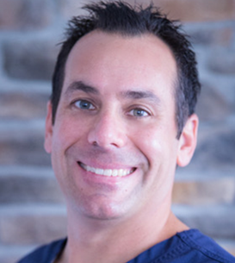
THE TEAM
Dennis Davis, DMD, MS - President
Board Certified Periodontist
Dr. Dennis Davis is a Diplomate of the American Board of Periodontology. He is well trained in all phases of non-surgical and surgical periodontal therapy. His undergraduate studies were completed at Florida State University, where he received a Bachelor of Arts degree in Biological Science. Dr. Davis went on to receive his Doctor of Dental Medicine degree in 2002 at Nova Southeastern University. After spending several years in general dentistry, he completed a Dental Implant Fellowship at Southern Illinois University. Dr. Davis obtained a Certificate in Periodontology from the University of Florida in 2007.
Notes:
Our management team has the experience and expertise to successfully execute on our business plan.

Slide 32
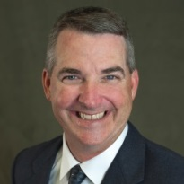
THE TEAM
Stephen Floyd, MBA, MA, BS
Chief Executive Officer
Mr. Floyd has over 25 years business management and consulting experience including marketing, human resources, strategic planning, operations, and process improvement. Since 2009, Mr. Floyd has concentrated on leading and growing medical, pharmaceutical, and dental organizations. Mr. Floyd’s educational credentials include a Master of Business Administration, a Bachelor of Science Degree with a Marketing concentration, and a Master of Arts in Theology.

Slide 33
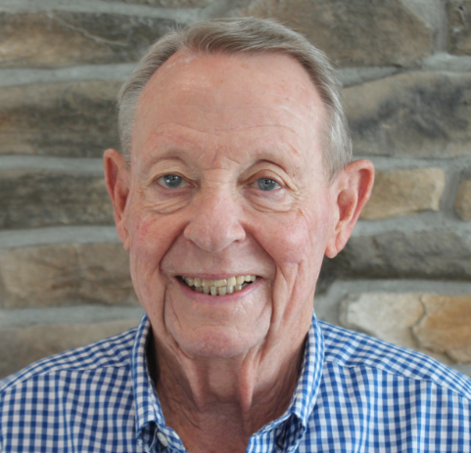
THE TEAM
John Schwin, Jr. , MBA, BS
Chief Financial Officer
Mr. Schwin has extensive financial management and consulting experience including senior financial positions in manufacturing, software and consulting companies while serving as Controller, VP Finance & Administration and Senior Consulting Associate. He has concentrated on accounting control incorporating implementation of profit improvement and cost control systems as well as simplified presentation of financial results. For the past 10 years he has utilized this background in dental practices. Mr. Schwin’s educational background includes BS-Business degree from Indiana University and MBA Program-Accounting at the University of Florida. After graduating from Indiana University he served a tour of duty with the U.S. Airforce in both non-commissioned and commissioned positions.

Slide 34
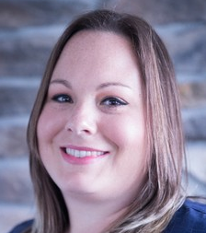
THE TEAM
Mrs. Christene Geller
Operations
Christene (Chrissy) was born and raised in south Florida and brings over 12 years of clinical and administrative dental experience to Village Periodontics and Dental Implant Center. She attended Broward College and Nova Southeastern University. Chrissy initially started as Dr. Davis' surgical assistant March of 2012 and grew into the management position. She has trained extensively and continuously attends training in practice management, team building, customer relations and human resources. She is very dedicated to the practice and strives to always make the practice even better.

Slide 35
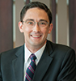

THE TEAM
John Arnold, JD
Legal
Healthcare companies and their investors rely on John Arnold for assistance with regulatory compliance, corporate governance and transactional matters. His experience includes advising both public and privately healthcare companies, as well as tax-exempt healthcare organizations, on Medicare billing and reimbursement issues, professional and facility licensure, HIPAA compliance and breach response, Stark and anti-kickback compliance, and applicable state healthcare laws and regulations. In addition, clients turn to John for assistance on transactional matters, including the negotiation and preparation of healthcare contracts, acquisitions, sales, mergers and joint ventures, and management services arrangements in the dental and medical space.
Notes:
Waller is one of the country’s leading law firms in the area of dental practice management and dental groups. For more than 20 years, Waller has counseled on a daily basis dental support services companies (DSOs) and dental groups operating throughout the United States – from startups to private-equity sponsored to public companies.

Slide 36
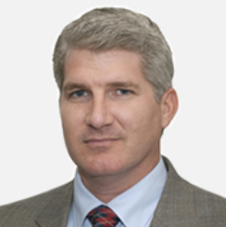

THE TEAM
Jason Meadows CPA
Accountant
Jason joined Frazier & Deeter in December of 2000 after having previously been with Arthur Andersen. Jason served as the Head of the Frazier & Deeter Tax Department during 2011 and 2012. Jason primarily specializes in complex business taxation consulting and compliance. His focus includes privately held, private equity backed and publicly traded entities. Jason has provided consulting services regarding corporate and equity compensation, including the use of stock options and partnership interests. On the transactional side, Jason has provided consulting services regarding mergers & acquisitions and business restructuring for purposes of asset liability protection.

Slide 37


THANK YOU
FUSION DENTAL

